Slide 1
Analyze data in a lake database

Slide 2
Introducing lake databases
1
Notes:
TALKING POINTS
Let’s go over how to Ingest Data with Apache Spark Notebooks in Azure Synapse Analytics.
How many of you have used Apache Spark pools in Azure Synapse Analytics, Azure Databricks, Apache Spark, HDInsight?
Talk about an example, of notebooks within the platforms provided.
PRESENTER NOTES AND GUIDANCE
Poll your audience, ask them for examples on data engineering in which they have used a notebook and tried to load data and the products we have to support that, get conversational on the topic, but don’t spend too much time.

Slide 3
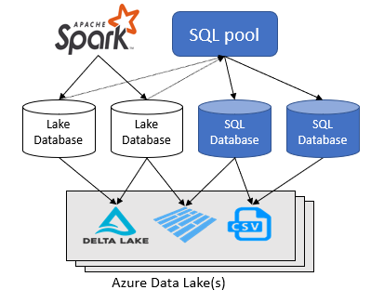
Lake databases
The Azure Synapse Analytics workspace enables you to create two types of databases on top of a Spark data lake:
Lake databases where you can define tables on top of lake data using Apache Spark notebooks, database templates, or Microsoft Dataverse (previously Common Data Service). These tables will be available for querying using T-SQL (Transact-SQL) language using the serverless SQL pool.
SQL databases where you can define your own databases and tables directly using the serverless SQL pools. You can use T-SQL CREATE DATABASE, CREATE EXTERNAL TABLE to define the objects and add additional SQL views, procedures, and inline-table-value functions on top of the tables.
Notes:
Azure Synapse Analytics allows you to create lake databases and tables using Spark or database designer, and then analyze data in the lake databases using the serverless SQL pool. The lake databases and the tables (parquet or CSV-backed) that are created on the Apache Spark pools, database templates, or Dataverse are automatically available for querying with the serverless SQL pool engine. The lake databases and tables that are modified will be available in serverless SQL pool after some time. There will be a delay until the changes made in Spark or Database designed appear in serverless.
Use SQL database to connect to external file sources using other auth methods like SAS tokens. Lake database only supports Azure AD (Entra ID) authentication on the data lake and Dataverse.

Slide 4
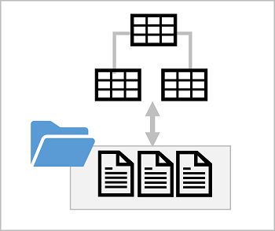


Lake database concepts
  Lake database schema:
  Relational tables
  Proven data modeling principles
  Consistent naming conventions
  Lake database storage:
  Parquet or CSV files in a
  data lake
  Managed independently
  of database
  Simplified data ingestion
  Lake database compute:
  Serverless SQL pool
  Apache Spark pool
Notes:
The concepts here build on the previously discussed concept of external tables. In effect, a lake database is a relational schema that abstracts data in files, so data in the database can be ingested and updated directly in the file system.

Slide 5
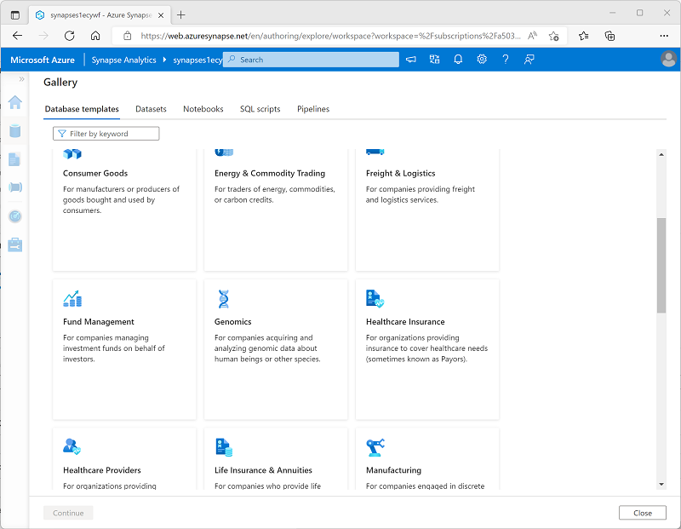
Database templates
  Pre-defined relational schema based on common business scenarios
  Use as a template for a new database or start with a blank schema and add pre-defined table definitions
Notes:
Point out that the database templates can be used to create a complete database schema, or you can start with a blank database and add individual tables based on the table definitions in the templates. The templates are based on common database design patterns in enterprise database scenarios; but can be customized to your specific needs.

Slide 6
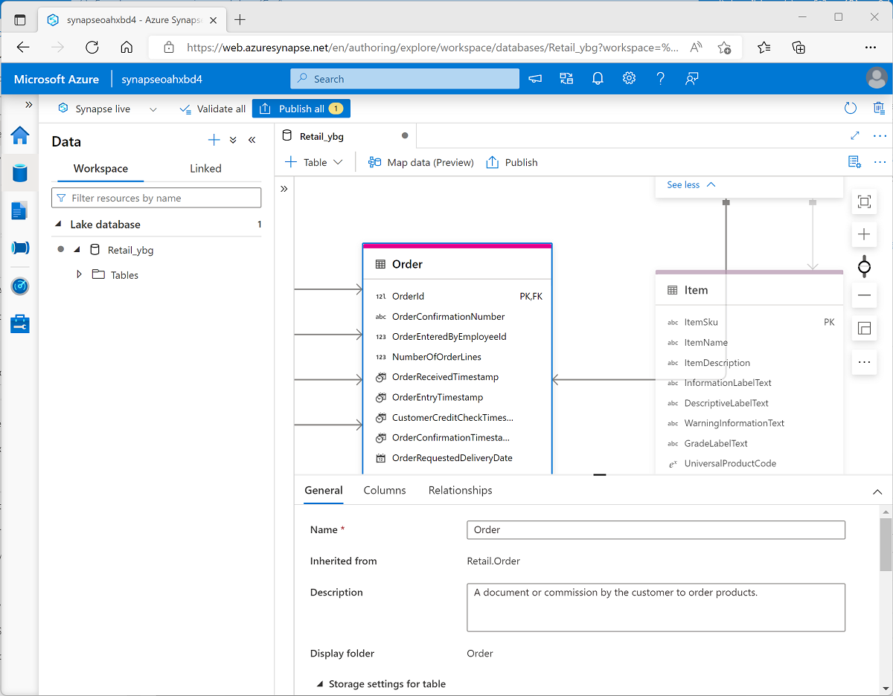
Database designer
  Visual tool for creating a database schema
  Add tables and specify:
  Name and storage settings for the table
  Names, key usage, nullability, and data types for each column
  Relationships between key columns across tables
Notes:
The database designer can greatly simplify the creation of complex database schema.

Slide 7
Use a lake database
USE RetailDB;
GO
SELECT CustomerID, FirstName, LastName
FROM Customer
ORDER BY LastName;
%%sql
INSERT INTO ‘RetailDB’.’Customer’ VALUES (123, ‘John’, ‘Yang’)
SELECT * FROM ‘RetailDB’.’Customer’ WHERE CustomerID = 123
Notes:
The tables in a lake database can be queried in a SQL pool, but also in a Spark pool because the database schema is defined in the metastore for Spark pools in the workspace.

Slide 8
LAB 4: Analyze data in a lake database
60 minutes
Notes:
TALKING POINTS​
​
Let’s put this into reality and show you how it works.​
​
All instructions and context are found in this repository​

Slide 9


Conference workshop presentations
Solliance Training
https://aka.solliance.net/azure-de-workshop
https://training.solliance.net

